Slide 1
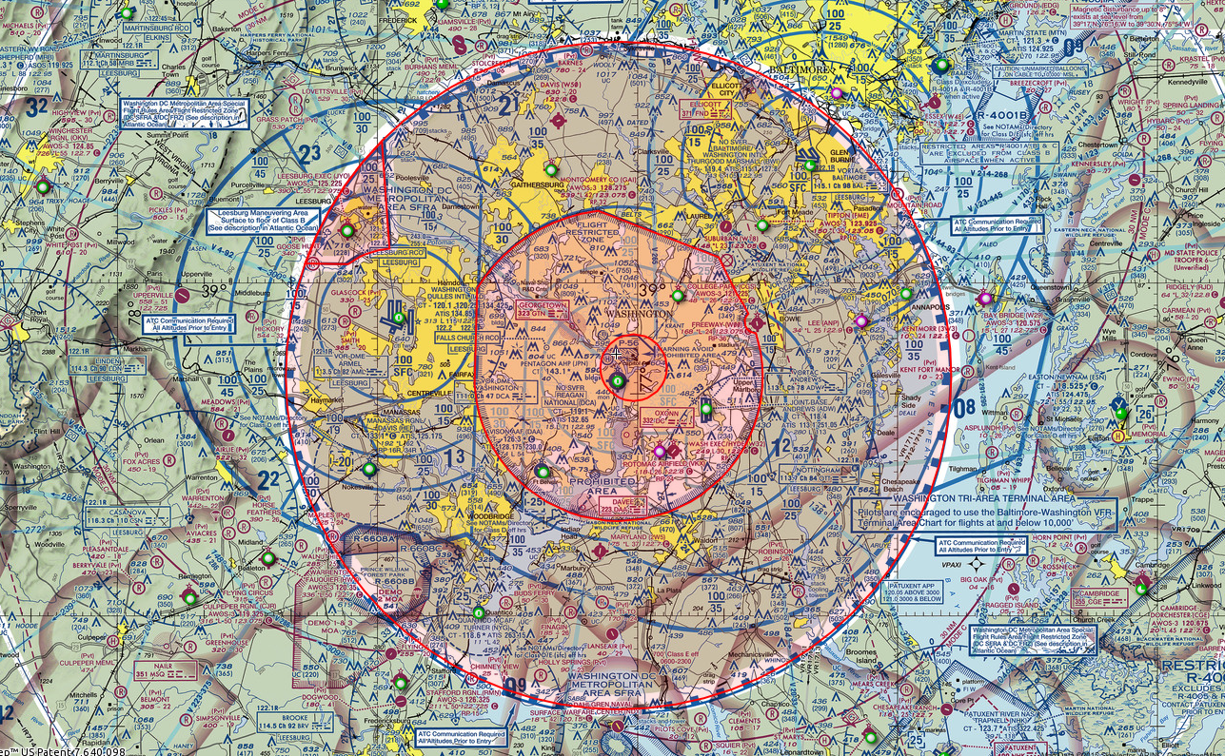
Washington, DC Airspace
FRZ/PIN/SFRA Seminar

Slide 2
Welcome!!
Our goal today is to demystify the Washington, DC airspace as it relates to General Aviation.
Contrary to popular belief (and some misinformation in the industry press) you CAN fly your private airplane here. All it takes is an understanding of some relatively simple requirements and …. common sense.
We’ll cover:
The Special Flight Rules Area (SFRA)
The Flight Restricted Zone (FRZ)
The FRZ PIN & How To Get One

Slide 3
Presenter: Stan Fetter
Commercial/Multi/Instrument
Flying in DC area since 1981.
Airport manager @ W32/Hyde since 2002
14+ years operating traffic watch flights in the DC area
First media waiver in DC area after 9/11
Why it matters….

Slide 4
Washington, DC Airspace Overview

Slide 5
Progress….
In the ensuing years, things have gotten easier.
First, approved pilots were allowed to move freely between the MD-3 airports.
Then, transients were allowed.
Next was the ability to get fingerprints at numerous locations around the country.
Then, the ability to go to different FSDO locations.
Next, elimination of the need to visit any FSDO.
And now – 1-stop shopping, do it all at one time. (Today.)

Slide 6
Washington, DC Airspace Overview
SFRA:
Special Flight Rules Area
30 Mile DME Radius from DCA, Roughly Follows Mode C Veil
Requirements:
Online SFRA Training
On Flight Plan
Before Entering:
  In Contact With ATC
  Squawking Discrete Beacon Code

Slide 7
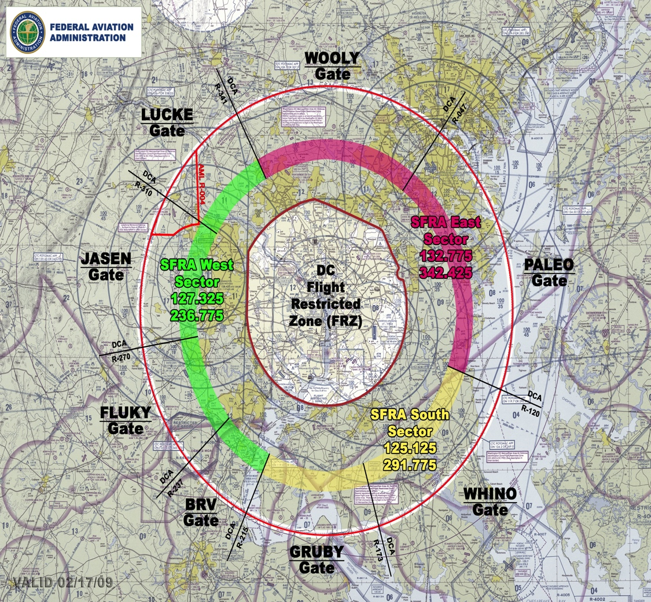
Washington, DC Airspace Overview
SFRA VFR GATES
Shown on Terminal Chart
Contact ATC on indicated frequency
Receive & DISPLAY beacon code BEFORE entering.
Expect “Transponder observed, proceed as requested….”
No “Cleared into….” or “Radar contact…”

Slide 8
Washington, DC Airspace Overview
FRZ:
Flight Restricted Zone
13-16 Mile Radius from DCA
Requirements:
All SFRA Requirements
Part 121/135 DCA Authorized
Military/Law Enforcement/Medivac
TSA Waiver

Slide 9
Washington, DC Airspace Overview
MD-3 Airports
W32, CGS, VKX
Requirements:
  All SFRA Requirements
  PIC Must Hold PIN
  TSA Waiver

Slide 10
Washington, DC Airspace Overview
Things that DO NOT get you into the FRZ airspace:
Filing IFR
Former or current military in civilian Tail #
Charter/Part 135
Flight Planning Contractor Said It Was OK

Slide 11
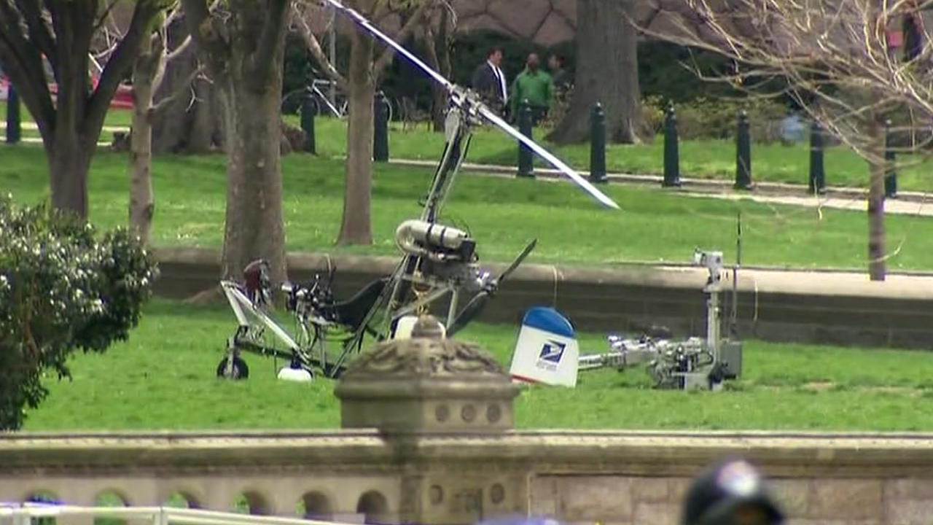
Washington, DC Airspace Overview
Delivering messages to Capitol Hill

Slide 12
Getting A PIN

Slide 13
Getting A PIN
A PIN for the FRZ and MD3 Airports is issued upon successful completion of SFRA training, a background check, and the submission of required documents to the airport sponsor.
The background check covers both criminal and FAA pilot history.
The criminal history check is completed by NATA on the basis of fingerprints.
The FAA records check is conducted in background once required documents are received and validated.

Slide 14
Getting A PIN
A PIN for the FRZ and MD3 Airports is issued upon successful completion of SFRA training, a background check, and the submission of required documents to the airport sponsor.
The background check covers both criminal and FAA pilot history.
The criminal history check is completed by NATA on the basis of fingerprints.
The FAA records check is conducted in background once required documents are received and validated.

Slide 15
Getting A PIN
We tried….
In the past when we’ve done these seminars, we’ve had NATA on site to take fingerprints, effectively making it a one-stop process. That, however, requires pre-registration along with instructions on what to bring and there wasn’t a way this year to make that work through the EAA site.
For those of you who happen to have some or all of the required documentation with you (more on that later) you’ll be able to submit that today and save some steps.

Slide 16
Getting A PIN
PIN Requirements:
FAA Licensed Pilot or Student Pilot
FAA Medical Certificate valid within the last 5 years or a Basic Medical Certificate, Unless Under Light Sport Rules
Completion of SFRA Training

Slide 17
Getting A PIN
Process, Part One:
Register with NATA at http://info.natacs.aero/maryland-three-program
Follow their instructions to register and get fingerprints taken. IGNORE everything else on that site about how to get a PIN.
Complete the “Fingerprint Control Form” on the NATA site and print it out. DO NOT SIGN OR DATE IT AT THIS TIME.

Slide 18
Getting A PIN
Process, Part One Continued:
Get fingerprints taken at a participating NATA site (list on their web site) or Local Law Enforcement. Find out if they need you to bring fingerprint cards, if so call NATA and they will be sent to you.
Take the NATA “Fingerprint Control Form” with you. This form MUST be signed IN THE PRESENCE OF THE FINGERPRINT COLLECTOR.
Some locations take fingerprints electronically, and in those cases the site will take care of submitting them.

Slide 19
Getting A PIN
Process, Part One Continued 2:
Most locations that take fingerprints electronically and some that use cards will take your Fingerprint Control Form and submit everything.
For some locations that use cards, you’ll have to do this – send the fingerprint cards and the Fingerprint Control Form to NATA at the address on the form. It is HIGHLY recommended that you use a service that provides tracking – USPS Priority Mail (about $7, 2-3 days) Express Mail, Fedex, or UPS.

Slide 20
Getting A PIN
Process, Part Two:
Submission of Required Documents

Slide 21
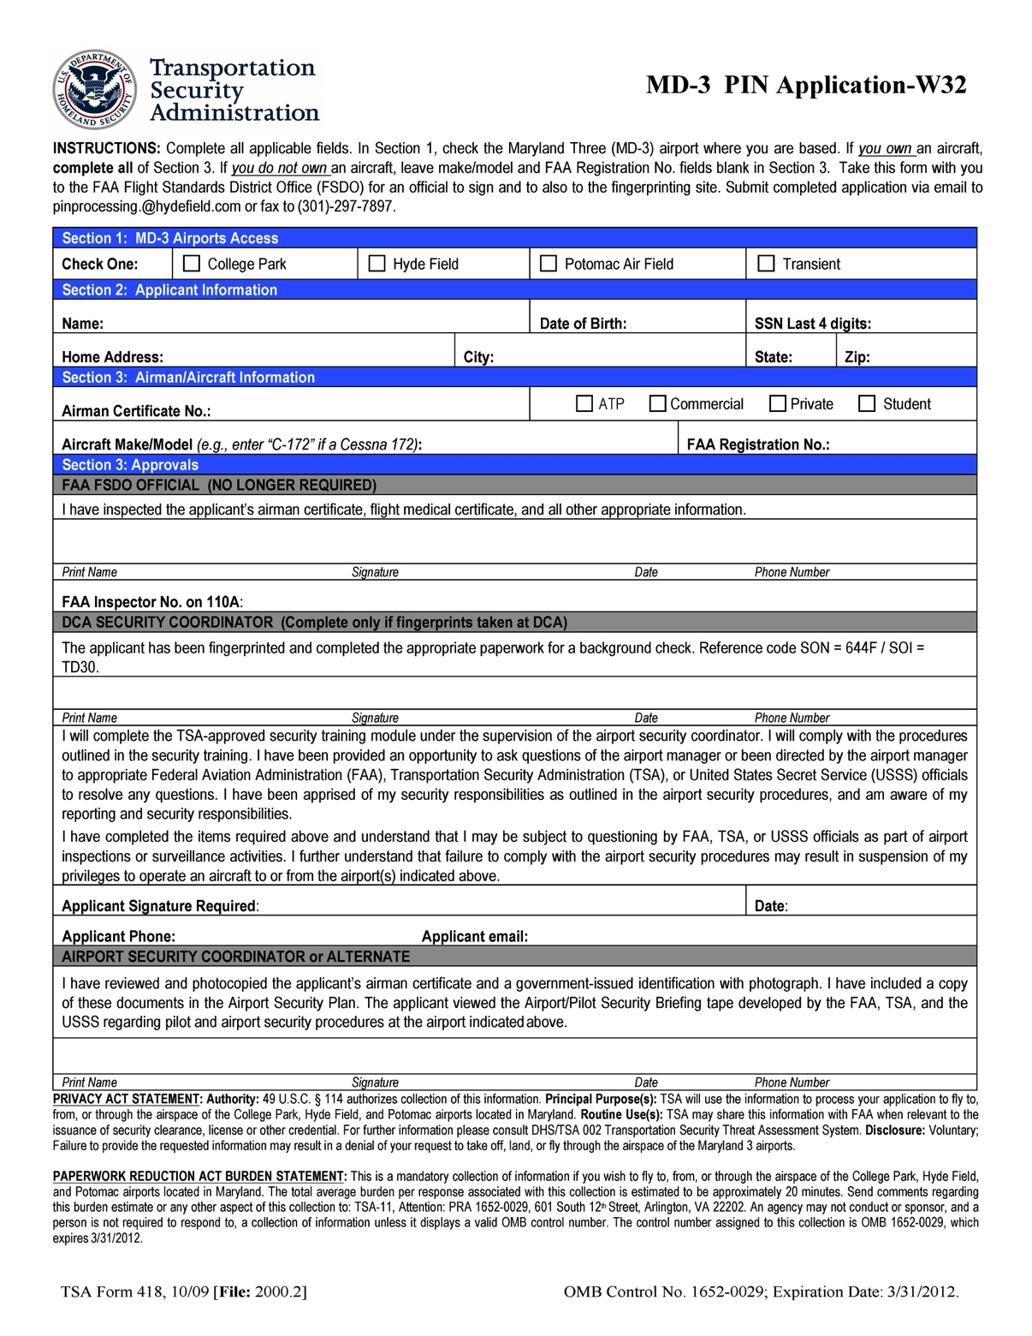
TSA Form 418
Check “Hyde Field” box in Section 1. Complete Sections 2 & 3.
Ignore this part!
Ignore this too!
Sign & date here!
Don’t forget contact information!

Slide 22
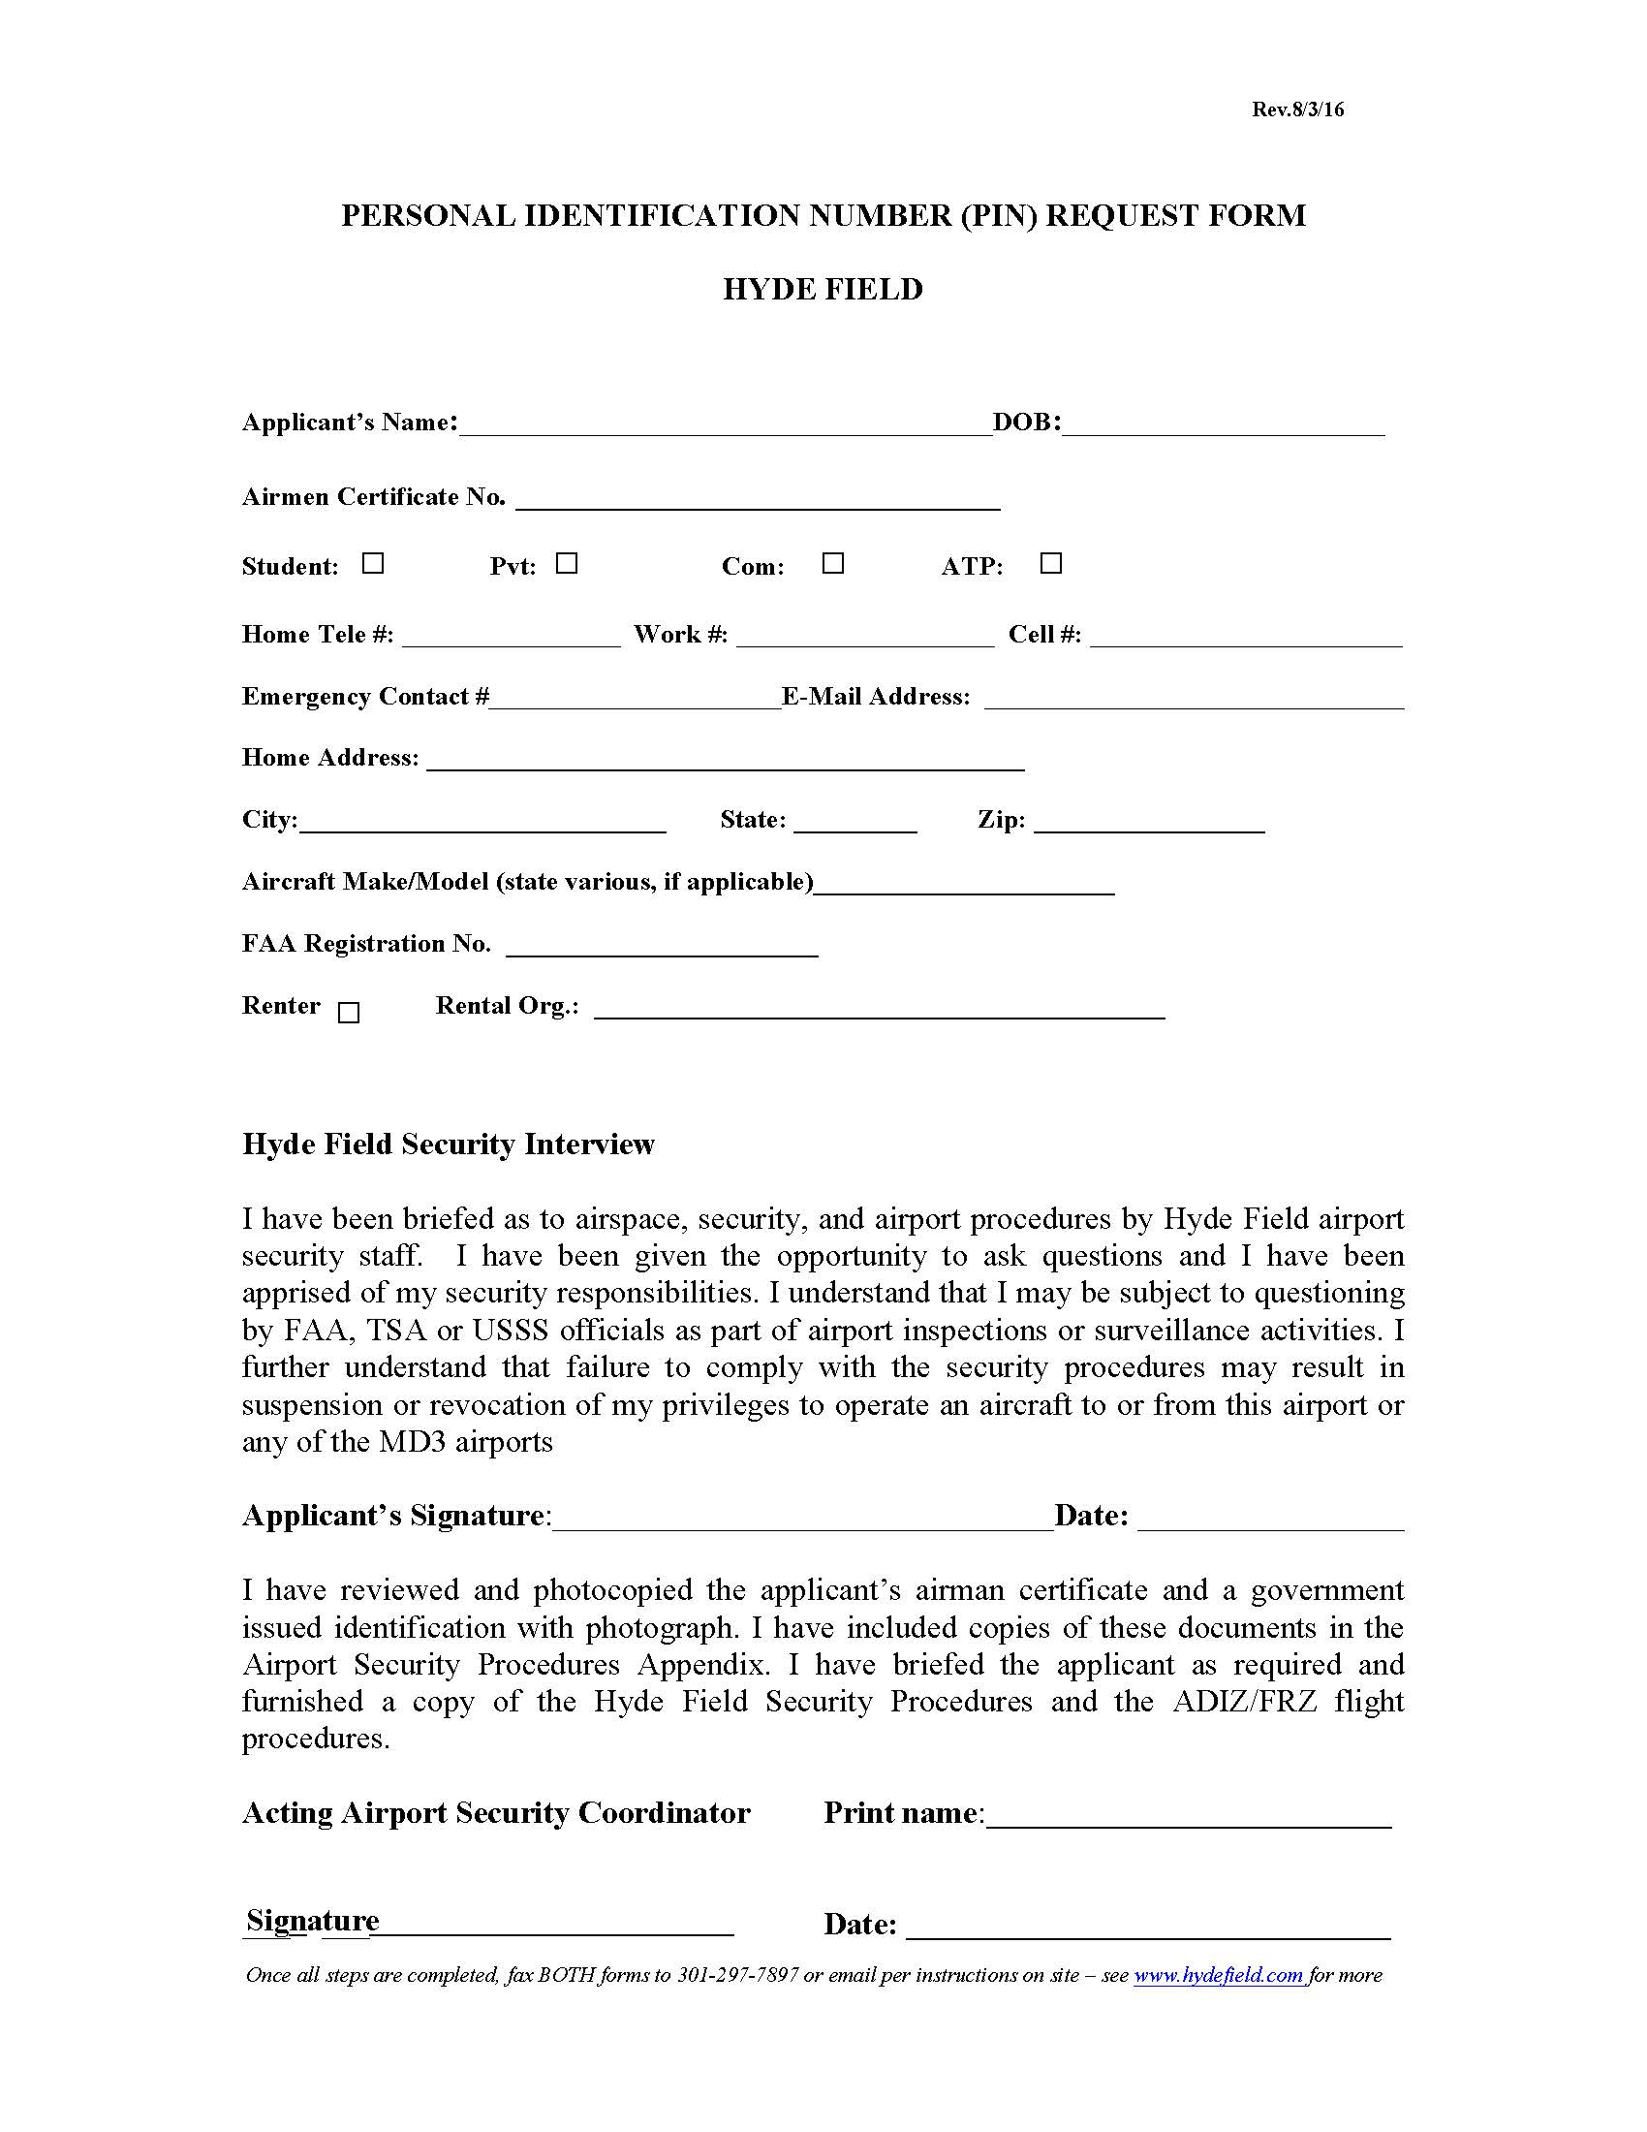
Hyde PIN Form
(W32 Only)
Complete top ONLY
DO NOT sign
Legible email & phone - important

Slide 23
Getting A PIN
In addition, copies of the following are required:
Copy of FAA License or Student Pilot Certificate*
Copy of FAA Medical**
Copy of Government-Issued Photo ID
Copy of SFRA Training Completion Certificate
    *Student pilot certificate must have been issued within the last 5 years
    **FAA medical must have been issued within the last 5 years. Not required for Sport Pilot Applicants.

Slide 24
Getting A PIN
Submit required documents:
Scan and send PDF (best) or JPEG/PNG files to pinprocessing@hydefield.com
Mail to:
Airport Security Coordinator
Hyde Field Airport
10275A Piscataway Road
Clinton, MD 20735-4426
Fax: 301-297-7897

Slide 25
Getting A PIN
The two components of the process, that is the background checks and the submission of forms and documents to the airport, are not dependent on each other. Either one can be done first, but nothing is finalized until both are complete.
Processing time from that point averages 10 days to 2 weeks; sometimes faster and sometimes not.
If questions come up in the course of the background checks, the responsible agency will contact you directly.
Once the process is complete, your PIN will be issued through airport staff.

Slide 26
Flying The FRZ
Day-to-day Operating Procedures – Filing, Flying, & Finishing

Slide 27
Using Your PIN
A PIN is required to use any MD 3 airport
A PIN does NOT get you into DCA, ADW, DAA
A PIN, once issued, does not expire.
A PIN can be revoked or suspended
A PIN is issued to a pilot, not an aircraft
A PIN to be used ONLY by the pilot to whom issued
Do not loan or disclose PIN or file for others
Contact issuing airport to recover a lost/forgotten PIN

Slide 28
Filing In General
FRZ flight plans MUST be filed on the phone with Ashburn AFSS @ 866-225-7410
This is the ONLY time anyone should ask for your PIN.
NO ONLINE FILING – NONE – NOPE – NADA
Tell briefer you are familiar with the SFRA and FRZ procedures
Valid Times: ½ hour before to 2 hours after.
FRZ flight plans accepted at least 1 week prior to flight.

Slide 29
Filing VFR
For No Flight Following - File from airport to VFR gate if departing, or from the gate to the airport for arrivals. Routing information NOT required.
For Flight Following – Tell briefer, include routing.
Local Flights to Practice Area, etc., - file to a radial/distance (i.e., DCA180 @ 20) & back.
FRZ Entry/Exit Each = 1 Flight Plan
Practice/TOL in SFRA, 1 flight plan each way.

Slide 30
Filing IFR
No differences from a normal IFR flight plan EXCEPT that you must file via phone to the Ashburn FSS hub @ 866-225-7410.
IFR Flight Plan will generate necessary SFRA & FRZ permissions.

Slide 31
Departure Procedures Within FRZ
Obtain release/clearance via phone from Potomac:
    From W32 or VKX: Mount Vernon Sector, 866-599-3874
    From CGS: Chesapeake Sector, 866-429-5882
    Receive beacon code & departure frequency
For IFR flights, departing VFR & activating IFR in air will save time. (It is still necessary to call Potomac by phone for beacon code & frequency)
Ensure that transponder is set to the CORRECT beacon code before takeoff, activated, & squawking altitude.

Slide 32
Departure Procedures Continued
Be aware of surrounding airspace – remain below the floor of, and clear of Class B unless otherwise instructed by ATC.
Hyde & Potomac, Depart to South or Southwest
College Park – Depart to North or East
Make usual radio calls on CTAF (You DO have 2 radios, right?)
Once airborne, contact Potomac on assigned departure frequency.
IFR flights follow clearance as usual.
VFR – DO NOT switch to 1200 until you’re ABSOLUTLY, POSITIVELY out of the SFRA.

Slide 33
Arrival Procedures - IFR
IFR – Process is transparent, follow ATC direction. IFR flight plan will generate needed SFRA & FRZ permissions.
Call field in sight & cancel IFR if able.
Remain on the assigned beacon code until shutdown.
Make radio calls in pattern but continue to monitor ATC in case of conflicts, changes, etc.
For missed approaches in IFR conditions, follow missed procedure.

Slide 34
Arrival Procedures - VFR
Contact Potomac on appropriate SFRA frequency before entering airspace. Give position relative to an airport, VFR gate, or intersection. “Potomac, Skyhawk seven-three-fox-romeo with you, two south of whisky twenty-nine, for whisky thirty-two.”
Wait for permission (NOT clearance) before proceeding.
Expect “transponder observed, proceed as requested” rather than “radar contact” or “cleared into the SFRA”
Proceed from entry point to FRZ then most direct route.
Remain on assigned beacon code until shutdown.

Slide 35
Missed Approaches & Go-Arounds
If remaining within immediate vicinity of the airport traffic pattern, ATC notification is NOT required.
IMPORTANT: Notify ATC if you leave the immediate vicinity of the airport, divert, etc. (More on this later)
Going missed in IFR conditions, follow IFR procedure & notify ATC.

Slide 36
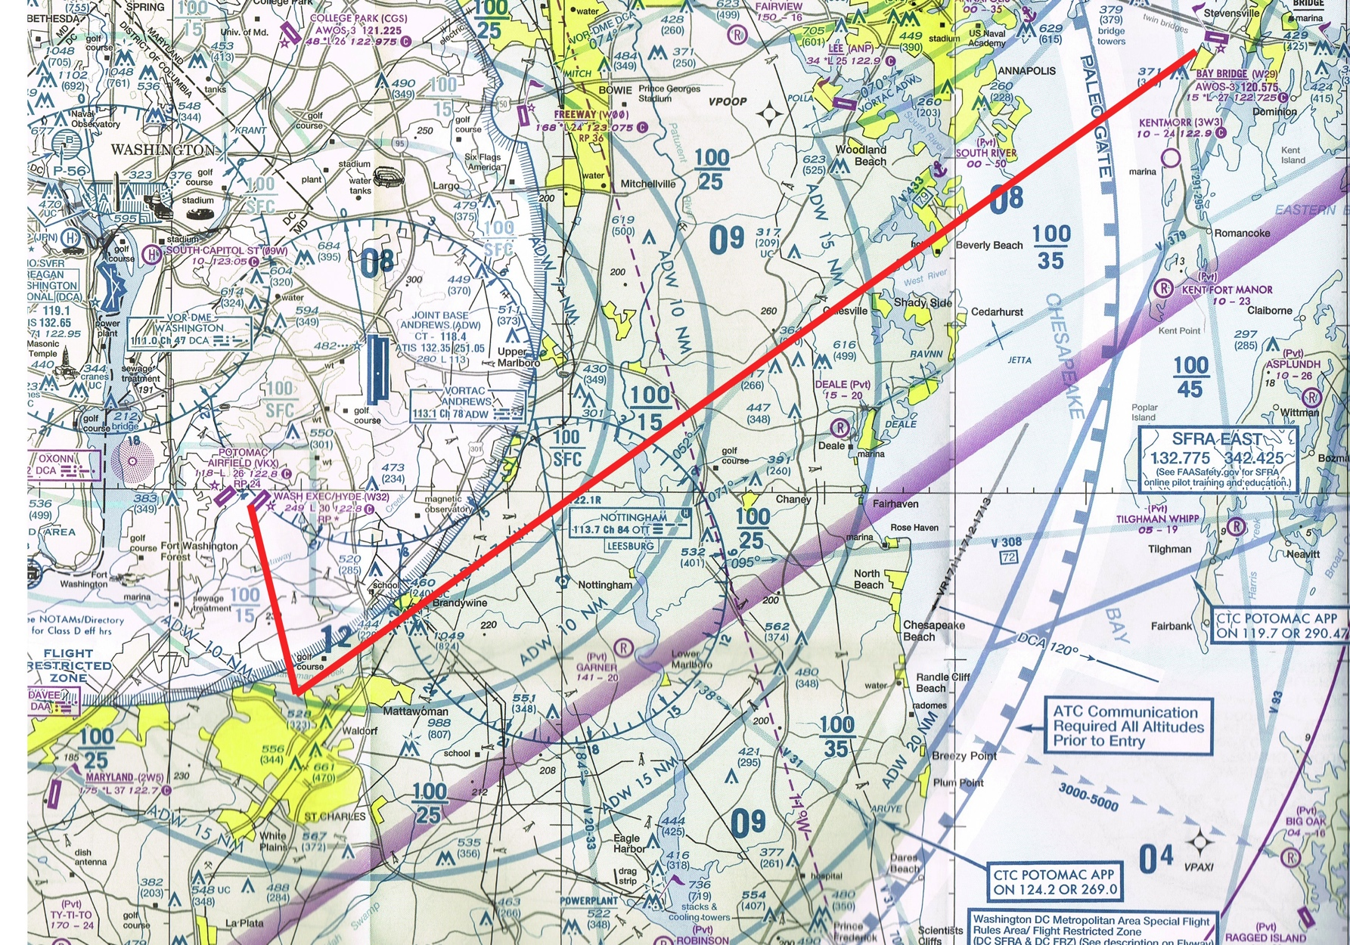
VFR FRZ Routing Via SFRA Gate
Depart FRZ via the most direct route, THEN proceed to filed gate.
Arriving, proceed from gate to point in FRZ nearest destination, then to destination.
Remain clear of Class B unless otherwise instructed.

Slide 37
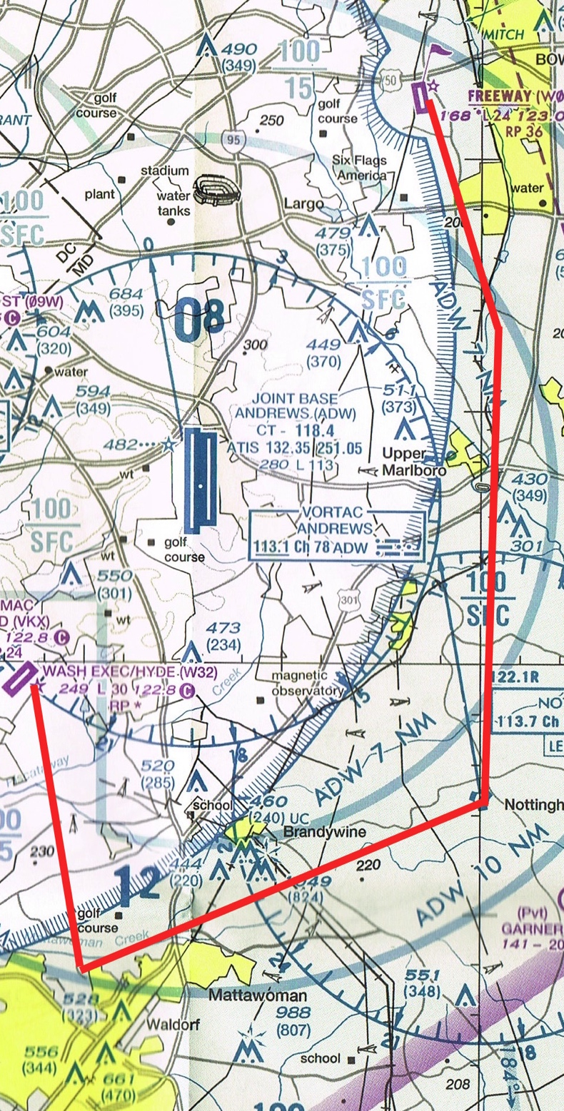
VFR Between FRZ Airport & SFRA Airport
Remain below the floor of, and clear of Class B unless a Class B clearance has been received.

Slide 38
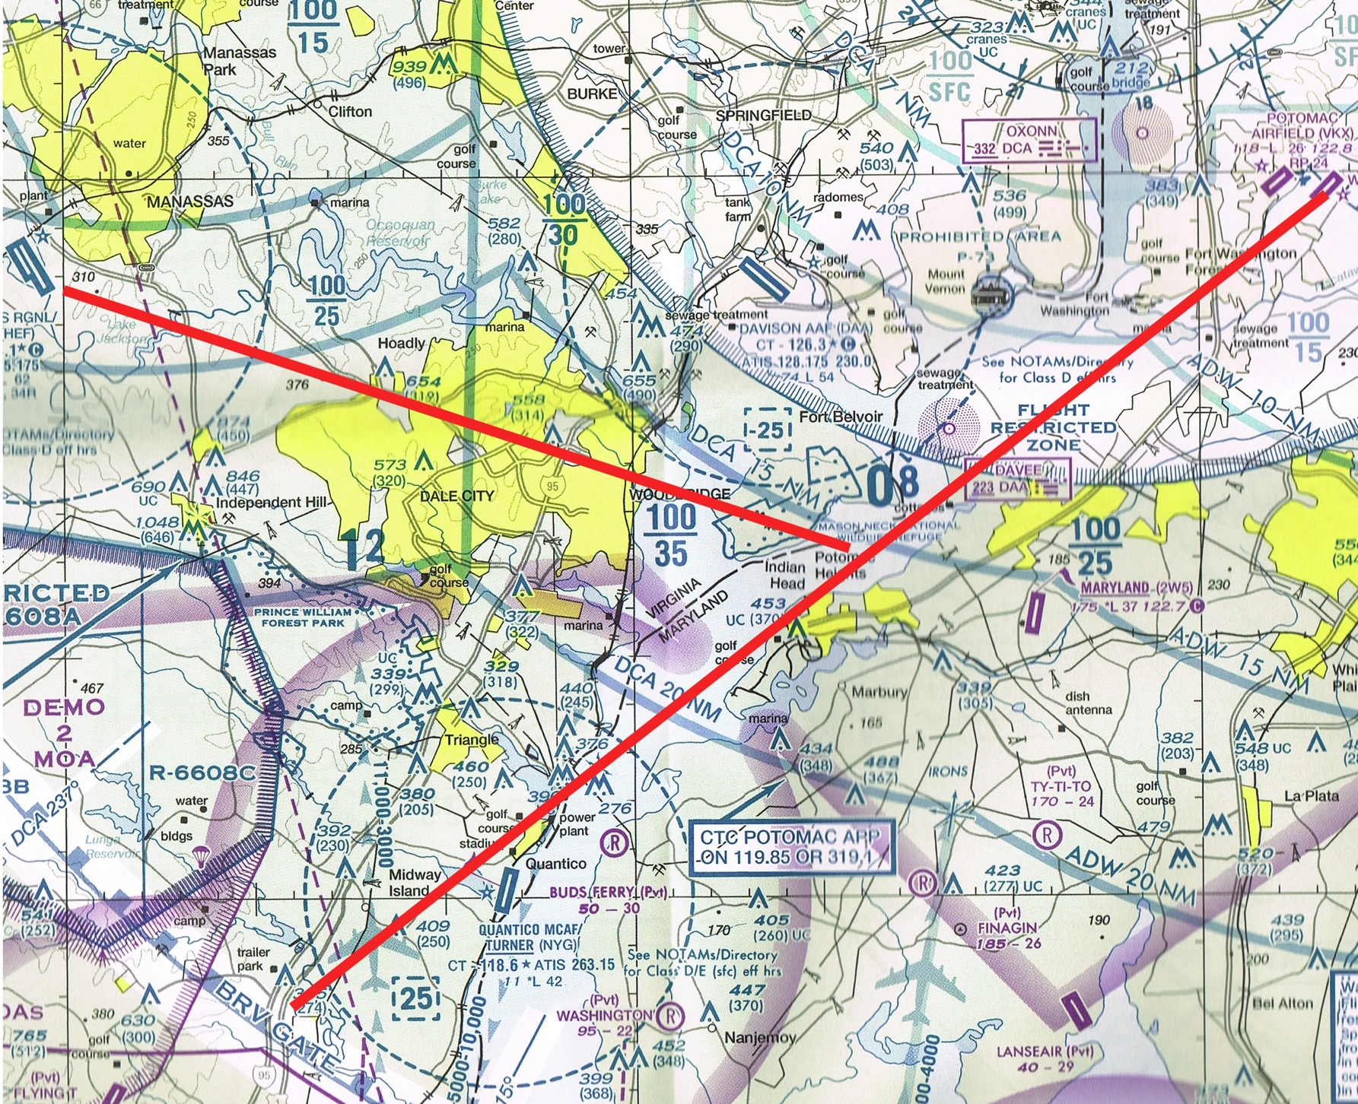
VFR, FRZ to West & Southwest
Again – most direct route out of the FRZ, then proceed on course.
Going towards HEF or points west, either avoid DAA or get Class D clearance.

Slide 39
Miscellaneous FRZ Considerations
Pattern work/TOL practice is not allowed
Practice approaches not allowed
“Loitering” not allowed; arrive or depart via shortest route (there is some leeway here, but don’t push it).
Sightseeing not allowed
Photo missions in FRZ = “loitering” and require TSA waiver
Secondary Locking Device Required – Throttle lock or prop lock, etc. if not hangared.

Slide 40
In Case of Difficulty….
For problems filing –
If the FSS specialist cannot validate your PIN, ask to speak to a supervisor. If the supervisor cannot resolve the situation contact the airport that issued the PIN or the TSA MD3 Program Director.
If the FSS specialist does not ask for your PIN, does not ask if you’re familiar with the FRZ & SFRA or seems unfamiliar with the process in any other way, make sure you called the correct location

Slide 41
In Case of Difficulty….
For ATC Problems on the ground
If Clearance Delivery doesn’t have your Flight Plan, hang up and call the Ashburn AFSS back (866-225-7410). Tell them Potomac doesn’t have your flight plan, then call Clearance Delivery back.

Slide 42
In Case of Difficulty….
In the air – If Potomac says they don’t have your flight plan, or it doesn’t have show authorization for the FRZ:
Tell the controller approximately when you filed your flight plan, and ask the controller to have his supervisor call Ashburn.
If they are too busy, remain clear of the SFRA and call FSS on the radio. Describe the problem, tell them approximately when you filed, and ask them to call Potomac.
If neither of those work, land and call AFSS by phone to refile.

Slide 43
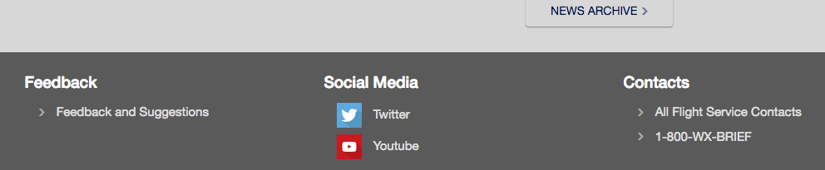
In Case of Difficulty….
PLEASE REPORT ANY PROBLEMS WITH FILING OR ATC!
Go to AFSS.com, all the way at the bottom of the page, and click Pilot Feedback

Slide 44
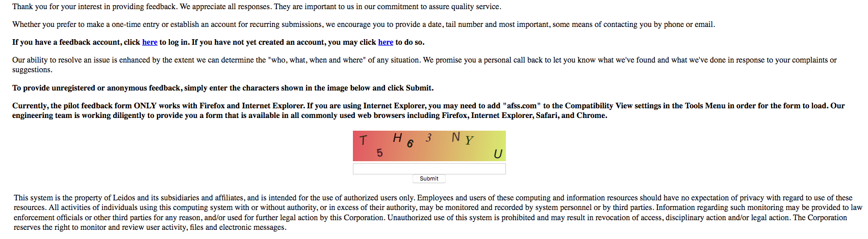
In Case of Difficulty….
The next page brings up links to a complaint form:
Provide as much detail as possible – times, frequencies, facility name, tail #. The resulting report is circulated on several levels will be used to investigate and address the issue. It WILL NOT come back on you, and you WILL receive a call back about findings and resolution.

Slide 45
Warning Systems
If you inadvertently get into airspace you shouldn’t, the main goal of the system is to let you know, get you out of there, and get you on your way.
The toolbox includes:
Radio contact via ATC or 121.5
Intercept by DHS Helicopter w/Message Board
Laser Warning System – Bright Flashing Red & Green Dot https://www.faa.gov/news/news_home/visual_warning/
(Your toolbox – File NASA Report!)

Slide 46
Lessons Learned
Hindsight…or the keys to uneventful flight in the FRZ, depending on your point of view.

Slide 47
Don’t Cut Yourself Off
Monitor ATC whenever possible, even after you’ve called the field in sight and been told “switch to Unicom approved.” (You DO have at least 2 radios, don’t you??)
Advantages, among others:
ATC can advise you of potential conflicts
ATC can contact you if something comes up
You can easily contact ATC if your plans change

Slide 48
Don’t Do Anything Unexpected
Situation…you’re coming into a FRZ airport at night and hear another aircraft in the pattern. You can’t see the other aircraft.
Reversing course and leaving the pattern to give the other aircraft room and/or time for you each to find the other might sense, but…..
LET ATC KNOW OF CHANGES IN PLANS!!!!

Slide 49
Stay Within Radar Coverage
Dropping below radar coverage may cause the ATC system to terminate your flight plan & drop your data block. Contact ATC if in doubt.

Slide 50
Radio Etiquitte
Washington, DC airspace is busy.
Controllers will appreciate concise, brief communication. Tell them what they need to know and leave the rest out.
Pay attention to the radio & don’t make them call you multiple times.
Your controller may be working multiple frequencies. Listen to what he’s saying and you can probably figure that out. Try not to step on others trying to respond.

Slide 51
Firearms
Generally, transporting a firearm across state lines is treated the same as in an automobile.
Once you arrive, the rules of that jurisdiction apply.
Check with destination airport in advance about their policies.

Slide 52
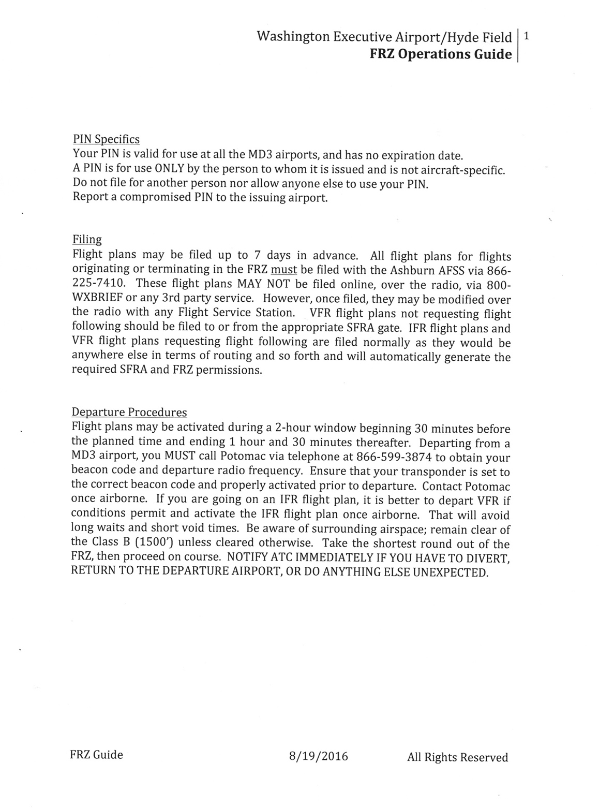
The Essentials….
A two page summary of FRZ procedures is available at Hydefield.com. This is continuously updated and includes the basics on filing as well as departure & arrival procedures.
This presentation is also available for download at Hydefield.com.

Slide 53
Things You Can Do With A PIN

Slide 54
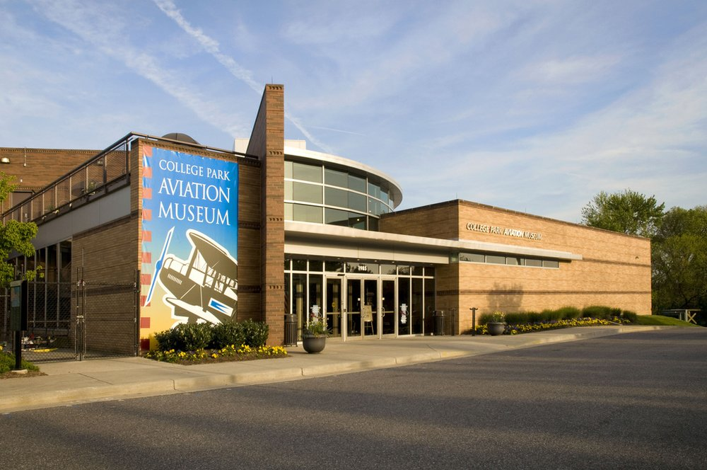
College Park Airport
Just NE of Washington, DC
College Park Aviation Museum & easy access to Metro

Slide 55
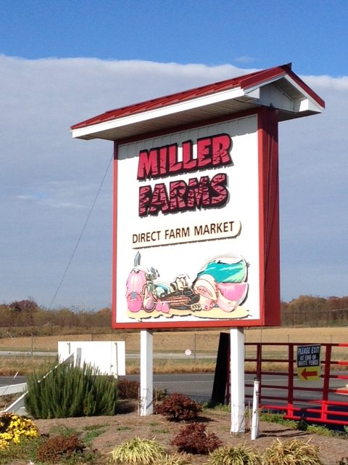
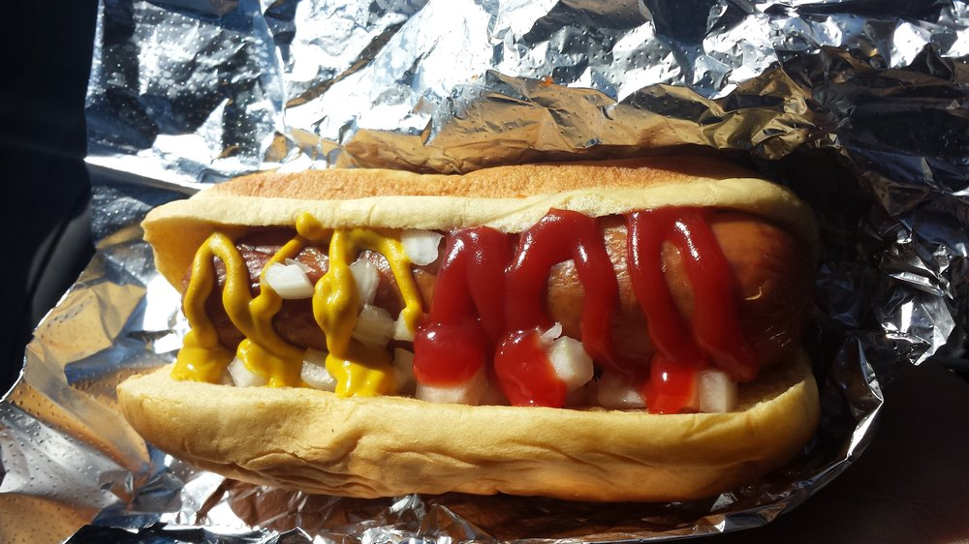
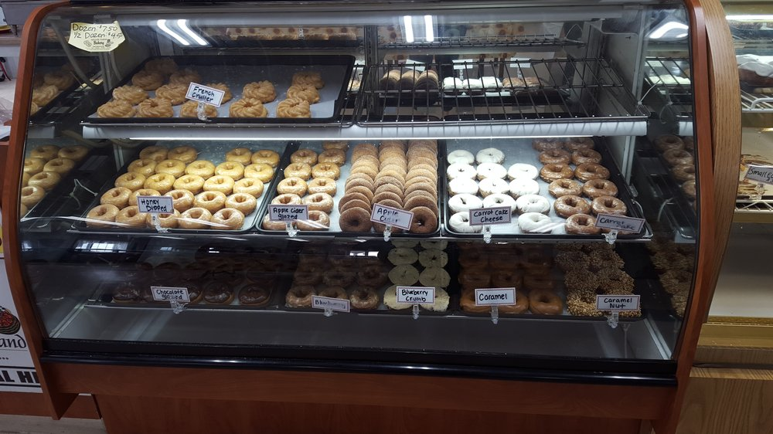
Hyde Field
10 Miles South of I95/I495/Washington Beltway
National Harbor & MGM Casino 10 minutes away
Miller’s Farm Market
  Homemade ice cream, donuts, cakes & pies
  Lunch counter w/dogs, burgers & Bar-B-Q

Slide 56
Summary
This concludes the presentation portion of the program and serves as the required briefing for issuance of a MD-3 PIN. Those of you who today complete this process will qualify to receive a PIN, subject to the results of the background and record checks.
Detailed information on FRZ operations and this presentation are available at hydefield.com.
You may also start a new application for a PIN at Hydefield.com, or through either of the other two MD-3 airports.

Slide 57

In Case Of Questions….
  Kathie Stapleton
  Maryland Three (MD-3) Program
  Industry Engagement Support –
  General Aviation
  Transportation Security Administration
  Phone: 571-227-3216
  Kathie.Howell@tsa.dhs.gov
Stan Fetter
Airport Manager
Washington Executive Airport/Hyde Field (W32)
301-234-0065
Stan@hydefield.com

Slide 58
Acknowlegements….
This presentation is a joint effort that would not exist were it not for by Helen Woods of Chesapeake Sport Pilot, John Cutcher, AOPA and Hyde Field.
We owe particular thanks to Helen for spearheading this effort & getting the ball rolling. Thanks also to Katie Pribyl, Nobuyo Sakata and Meghan McCutcheon, all of AOPA for arranging the space, food, and coordination with NATA for the on-site fingerprint operation.
Finally, we owe a huge debt of gratitude to Kathie Howell at TSA, who has worked tirelessly to streamline and improve the entire FRZ process and experience.

Slide 59
Finally….
Questions?

